Slide 1

D3.js
CMPT 384 – Information Visualization
Lab 4
Course Instructor: Debajyoti Mondal
Lab Tutorial Instructor : Arman Heydari( arman.heydari@usask.ca )

Slide 2
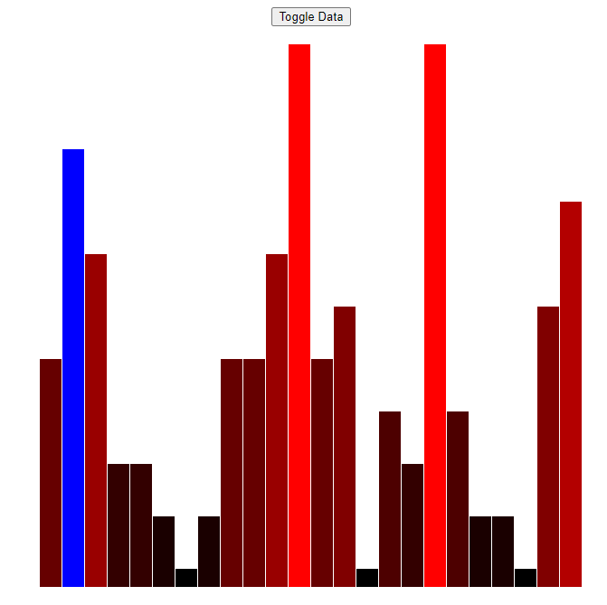
Agenda
D3 Bar Chart with scale
D3 Event Handler
D3 Transition (Animation)

Slide 3
D3 Rectangle Draw
Rectangle is another primary shape
(x, y)
Required Attributes
width
Top-Left Co-ordinate (x, y)
width
height
height
<rect x="50" y="20" width="150" height="150“></rect>

Slide 4
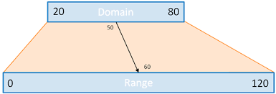
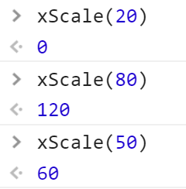
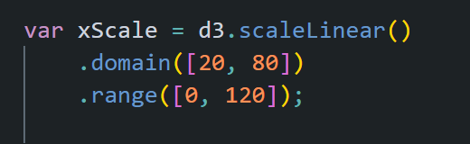
D3 Scales – Linear Scale
http://www.jeromecukier.net
Domain – what we have, e.g. data range
Range – what we want, e.g. pixel range for chart

Slide 5
D3 Transition
Select Elements
Join Updated Data
Transition
Define the duration of transition (in milli-second)
Define the type of transition (with ease)
Different type of animation in d3 library
https://observablehq.com/@d3/easing-animations

Slide 6
Start the server
Microsoft Windows [Version 10.0.15063]
(c) 2017 Microsoft Corporation. All rights reserved.
C:\> python -m SimpleHTTPServer 8888
C:\Users\jyoti\AppData\Local\Programs\Python\Python37-32\python.exe: No module named SimpleHTTPServer
C:\> python -m http.server 8888
Serving HTTP on 0.0.0.0 port 8888 (http://0.0.0.0:8888/) ...

Slide 7
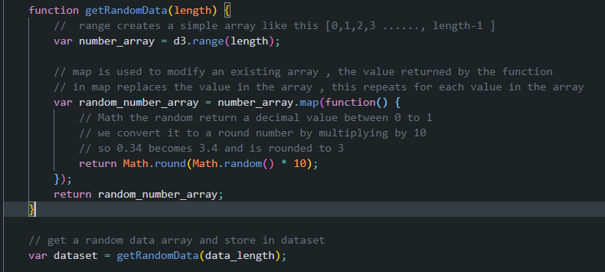
Generate Random Number

Slide 8
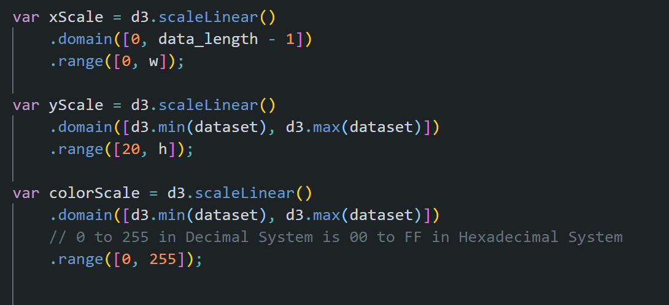
D3 Scales

Slide 9
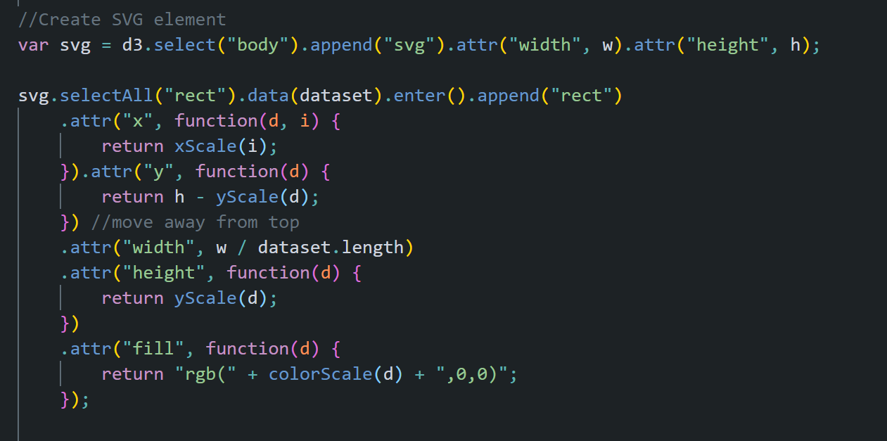
Chart Creation

Slide 10
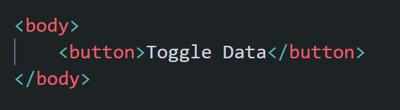
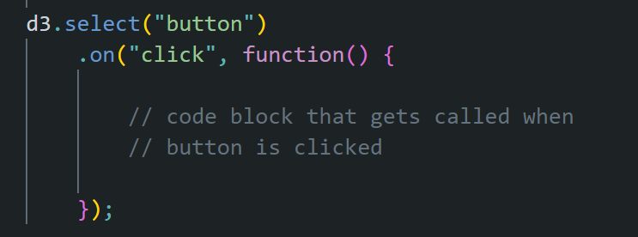
Event Handler – HTML Tag
HTML TAG
SCRIPT TO ATTACH EVENT

Slide 11
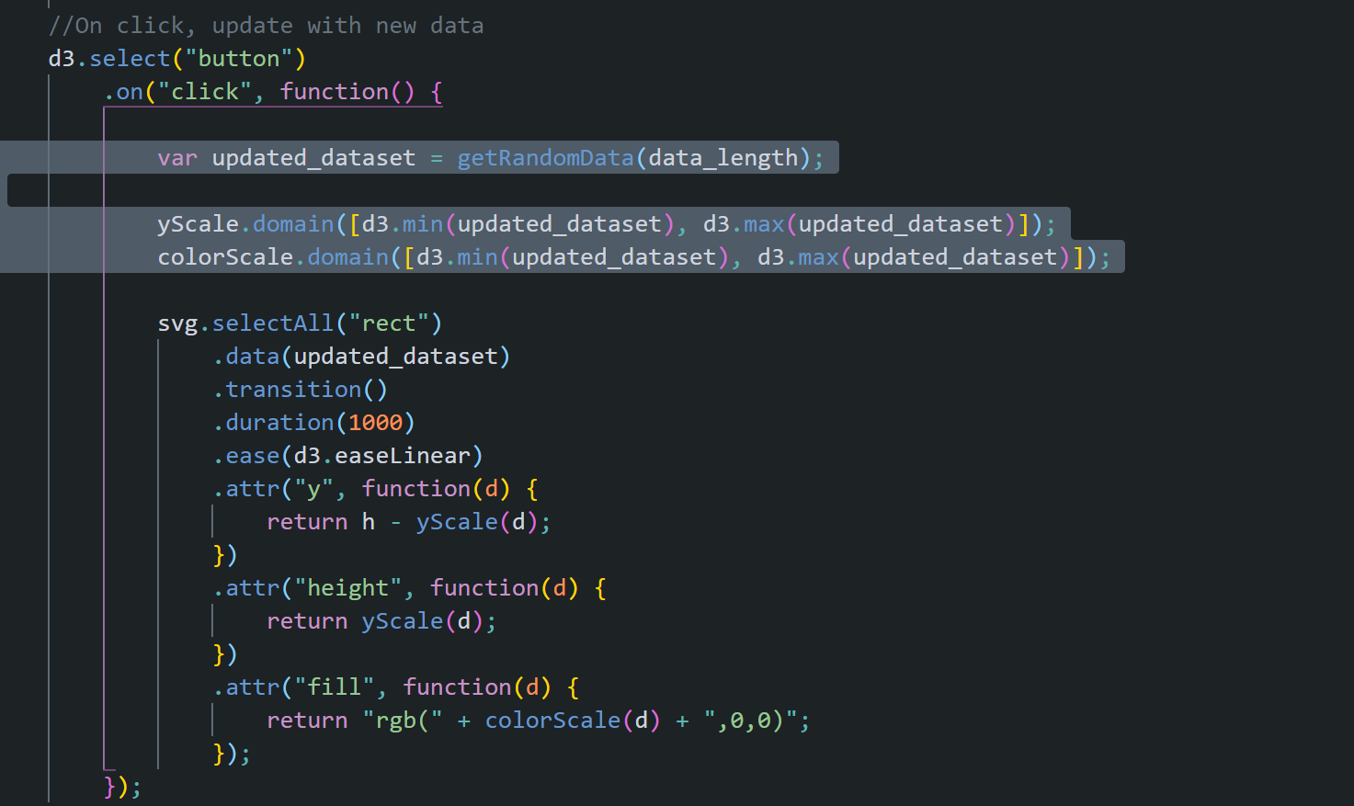
Event Handler – HTML Tag

Slide 12
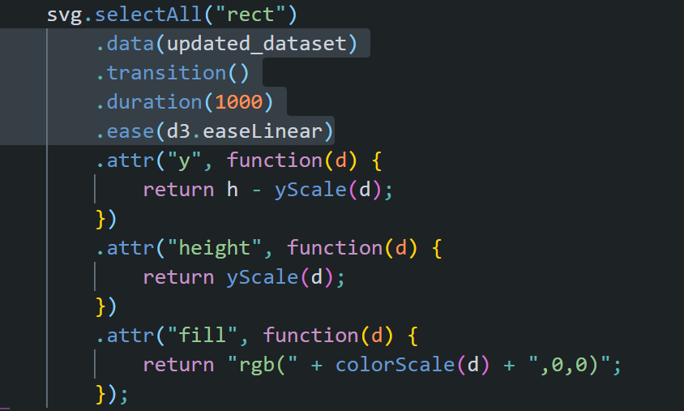
Basic Codes for Animation

Slide 13
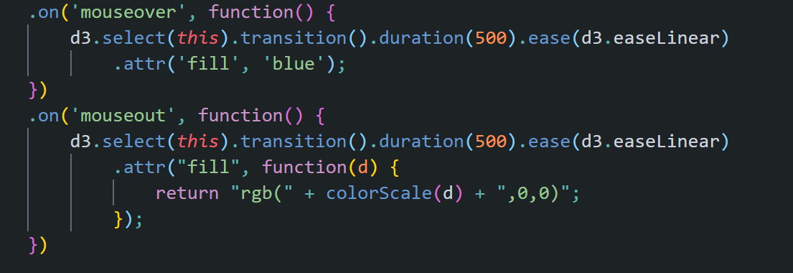
Event Handler for SVG Tag

Slide 14
Try this:
Try to create example_challenge.html on your own

